Slide 1

MARDS
REFORMING DOCTORAL STUDIES IN MONTENEGRO AND ALBANIA – GOOD PRACTICE PARADIGM
Grant: 598465-EPP-1-2018-1-ME-EPPKA2-CBHE-SP
7th Consortium Electronics Meeting
November 02-05 Podgorica, Montenegro, 2022

Slide 2
MARDS
REFORMING DOCTORAL STUDIES IN MONTENEGRO AND ALBANIA – GOOD PRACTICE PARADIGM
Grant: 598465-EPP-1-2018-1-ME-EPPKA2-CBHE-SP
Summary on achievements
Prof. dr Radovan Stojanović

Slide 3
Project Overview
15 Partners
  EU (5) : University of Vienna, University of Zagreb, University of Maribor, University of Banska Bistrica, Association of professionals in doctoral education.
  ME (5): University of Montenegro, University of Donja Gorica, Ministry of education of Montenegro, Ministry of Science of Montenegro, Montenegrin Chamber of Commerce,
  AL(6): University of Schroder “Luigj Gurakuqi”, Technical University of Tirana, Vlore University, University Metropoliten Tirana, Ministry of sport and education of Albania.
Coordinator: University of Montenegro
EU garnt (all partners): 868.120 EUR, UCG 201.740 EUR (23.2%), Staff: 61,460.00, Travel: 17,770.00, Stay: 34,560.00, Equ: 57,950.00, Sub: 34,000.00
Duration: 4 years, NOV 15 2018- NOV 14 2022

Slide 4
General objectives
To reconstruct Albanian and Montenegrin systems of doctoral education in line with Salzburg Principles
to establish sustainable and modern Pilot Joint Doctoral Schools between two friendly neighbours partner countries that will serve as an example of “good practice” for the WB Region.

Slide 5
Specific objectives
to reconsider the existing national policies/standards for doctoral studies in two countries and their compatibility with EU practices.
to develop and propose a new model of doctoral studies in two countries, adapted to the acquired experiences over past decades and current and future countries’ needs.
to propose a sustainable method of financing doctoral studies in two countries on national levels.
to establish two Joint Doctoral Schools
"Natural sciences and Technology for Sustainable Development" with place in Montenegro (Podgorica)
“Economy and Tourism for Sustainable Development” with place in Albania (Shkoder) as the recommendable examples of cross-border PhD programmes.
to establish a sustainable cooperation with EU partners and established Doctoral School in order to maintain developed standards.

Slide 6


Specific outcomes
Report on existed doctoral education in Montenegro and Albania with Action plans.
Proposal of basic legal documents including the model of funding doctoral studies in Montenegro and Albania.
Conference on PhD education in Montenegro and Albania.
Guidelines and recommendations for WB academics and professionals in Doc. studies.
Training staff and support.
Providing infrastructural and human resources
Accredited Joint Pilot Doctoral School: "Natural sciences and Technology for Sustainable Development" with place in Montenegro, Podgorica,

Slide 7

Specific outcomes
Accredited Joint Pilot Doctoral School: “Economy and Tourism for Sustainable Development” with place in Albania , Shkoder.
The First Scholarships for doctoral studies in two countries based on recommended funding model (if allowed by policy makers)
MARDS Doctoral Colloquium of first PhD generation enrolled under title “Science, Technology and Services for Sustainable development”,
Providided model of cooperation academia – nonacademia in term of MARDS
Providing sustainability of the achieved results

Slide 8
What we are proud of?
We change the system of PhD studies in Montenegro (modern approach, lower fees, intensive work, motivated candidates and teachers, mobility, research, publications, the tuition fee for doctoral studies has been reduced to symbolic 0€-€250- €750 per semester. ). In addition, the MARDS project contributed to the improvement of other policies and measures in doctoral education in Montenegro, e.g. at the University of Montenegro.
We developed, accredited, licensed and start up the first international multidisciplinary PhD programme in Montenegro, https://www.mards.ucg.ac.me/PhD/ .
The first generation students made great progress The MARDS program attracted most of the students enrolled in Ph.D. studies (16 studies programs) at the University of Montenegro in the 2021/2022 academic year. As many as 15 students out of a total of 93 are enrolled in this program (16%.). At the end of the academic year, all enrolled students mastered the defined curriculum with more than 75 % of success. All of them defended their colloquium works within Doctoral Symposium . The students were very proactive in mobility, their research stays at a partner institution, and 83% spent that stay, mainly at the University of Maribor.

Slide 9
What we are proud of?
The MARDS is a “de facto and de jure” international program. It originated from an international project, conducted in English by international institutions and professors, including international students. Circa 36 % of the enrolled students of the first generation completed their previous level of education at one of the foreign universities. This percent in 2nd generation goes to 90%. Some of them returned to Montenegro to continue their studies and professional development. About 50% of professors and supervisors were from foreign universities. About 40% of all authors, at Symposium, were out of Montenegro. The Program offers opportunities for the scientific diaspora of Montenegro and the wider Western Balkan.
We have just entered the second generation.
We have established traditional Colloquium for Doctoral Students, the first in history of WB DS, www.doc-me.com .
We have become an good example in the Region on modern DS.

Slide 10



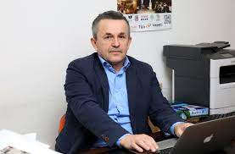
Programme
coordinator
Radovan Stojanović, PhD, full professor at the Faculty of Electrical Engineering, University of Montenegro

Slide 11

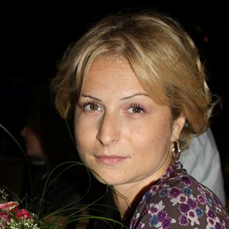
Students of the first generation of international doctoral studies "Sustainable Development" at the University of Montenegro
Ana Radović
Master of Science – Chemical technology
Manager of Department of accreditation laboratories and inspection bodies, Lead assessor for laboratories and inspection bodies Accreditation body of Montenegro

Slide 12
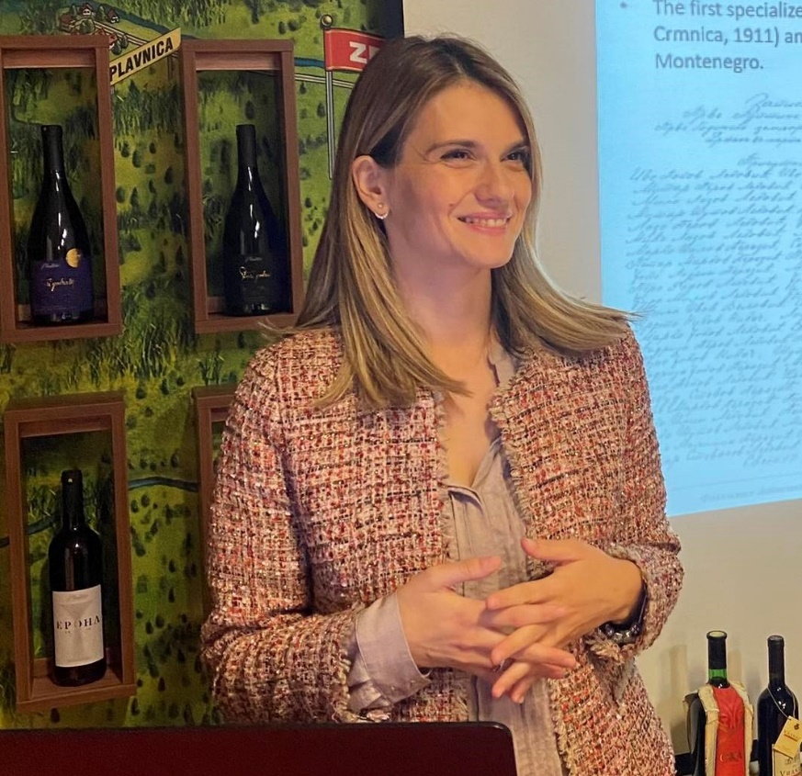
Students of the first generation of international doctoral studies "Sustainable Development" at the University of Montenegro
Anita Martić
Master of Science - Sustainable Agriculture
Plant protection technologist at 13 Jul-Plantaze

Slide 13
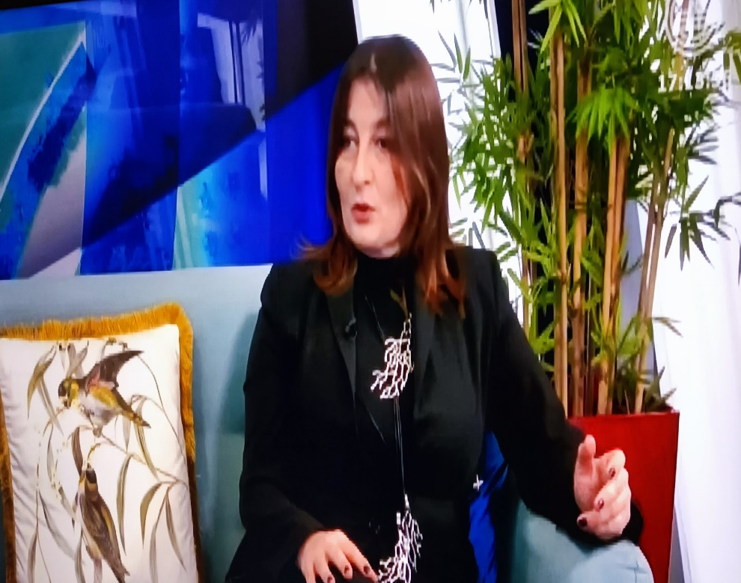
Students of the first generation of international doctoral studies "Sustainable Development" at the University of Montenegro
Branka Knežević
Master of Science - Biology
Deputy Secretary in Secretariat for Spatial Planning and Sustainable Development of Capital City Podgorica

Slide 14
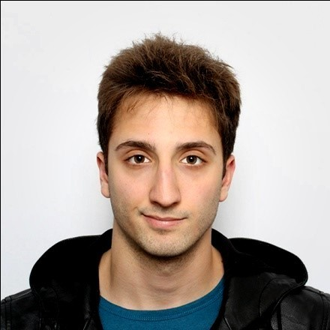
Students of the first generation of international doctoral studies "Sustainable Development" at the University of Montenegro
David Kočović
Master of Science – Food Technology and Proccesing
Head of Laboratory at “Institute for medicines and medical devices of Montenegro”

Slide 15
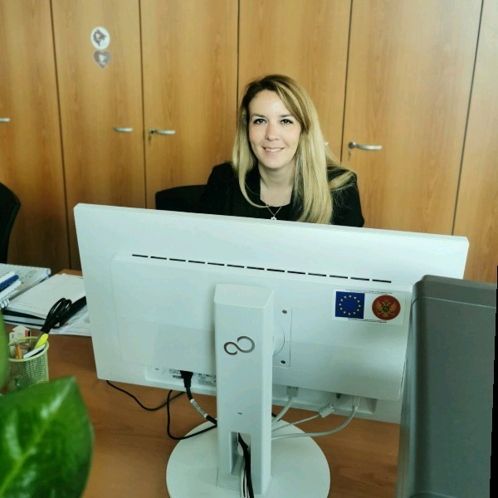
Students of the first generation of international doctoral studies "Sustainable Development" at the University of Montenegro
Ivana Mitrović
Master of Science –Ecology
Advisor at Environmental Protection Agency Montenegro

Slide 16
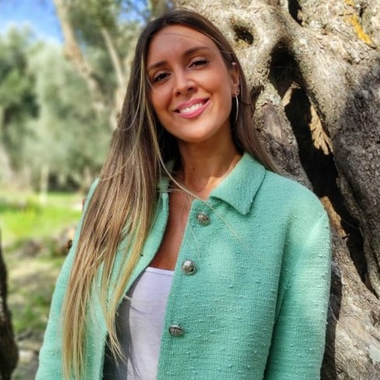

Students of the first generation of international doctoral studies "Sustainable Development" at the University of Montenegro
Maša Jovanović
Doctor of Veterinary Medicine
Dr vet. Med RoyalVet

Slide 17
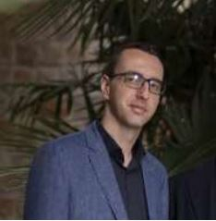
Students of the first generation of international doctoral studies "Sustainable Development" at the University of Montenegro
Mladen Femić
Master of Science - Geodesy and GIS
Land use and surveying lead engineer in Project manager unit for the Bar-Boljare highway Project
Monteput doo

Slide 18
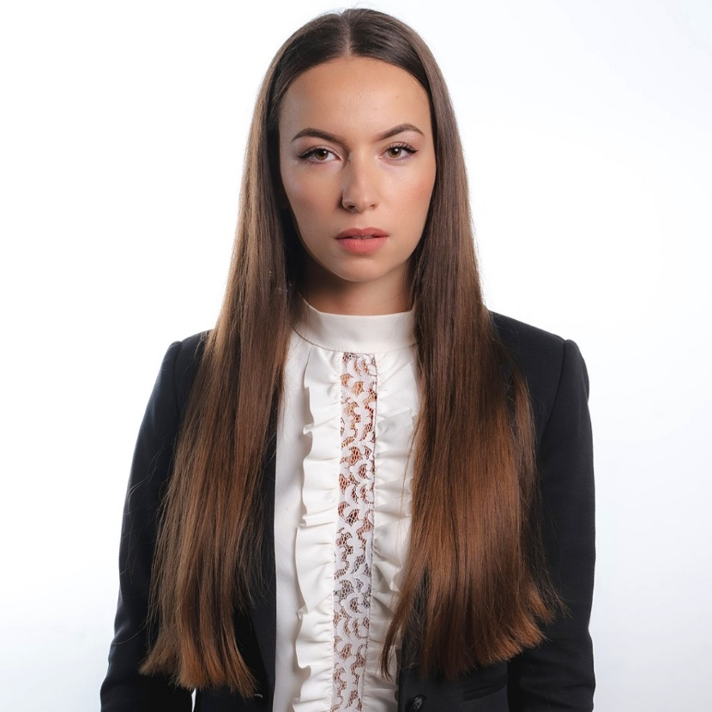
Students of the first generation of international doctoral studies "Sustainable Development" at the University of Montenegro
Neda Bošković
Master of Science- Environmental Protection
PhD student - Environmental Protection
Professional person for performing safety at work

Slide 19
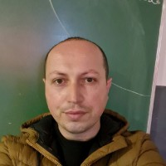
Students of the first generation of international doctoral studies "Sustainable Development" at the University of Montenegro
Osman Šurla
Master of Science – Biology
High-school teacher of biology, life sciences and health education

Slide 20
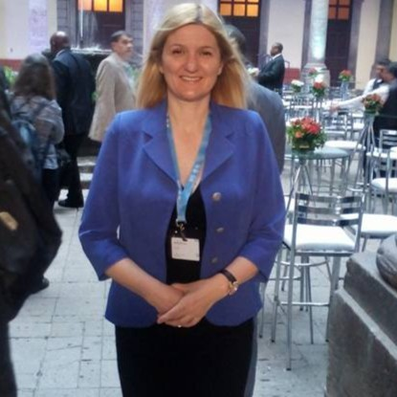
Students of the first generation of international doctoral studies "Sustainable Development" at the University of Montenegro
Sanja Pavićević
Master of Science - Physics
Consultant/Freelancer

Slide 21
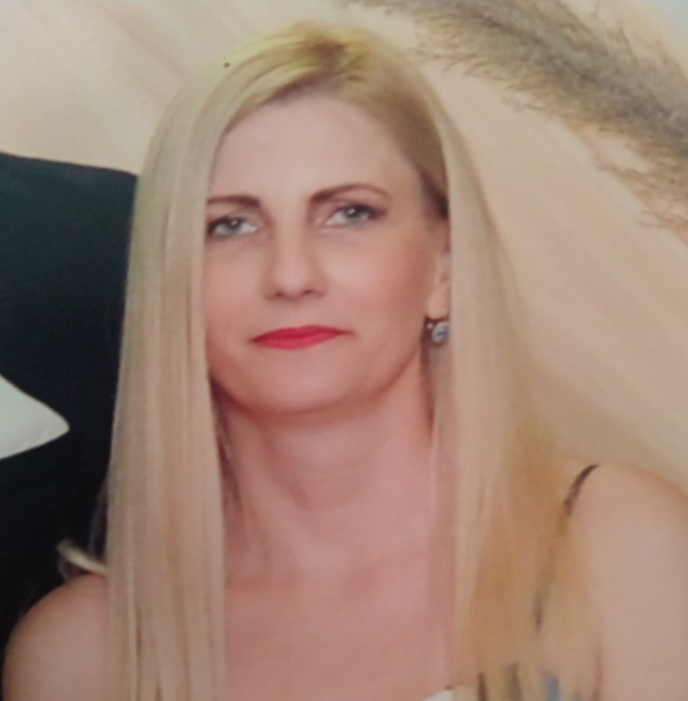
Students of the first generation of international doctoral studies "Sustainable Development" at the University of Montenegro
Snežana Lješnjak
Master of Science – Ecology
Teacher of Biology at Primary School "Marko Miljanov"

Slide 22
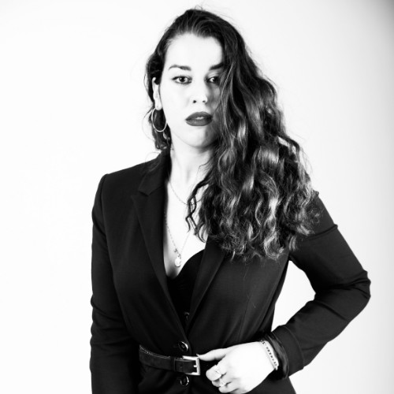
Students of the first generation of international doctoral studies "Sustainable Development" at the University of Montenegro
Stefanela Žarković
Master of Science - Architectural technology and construction
Architect at Zetagradnja

Slide 23
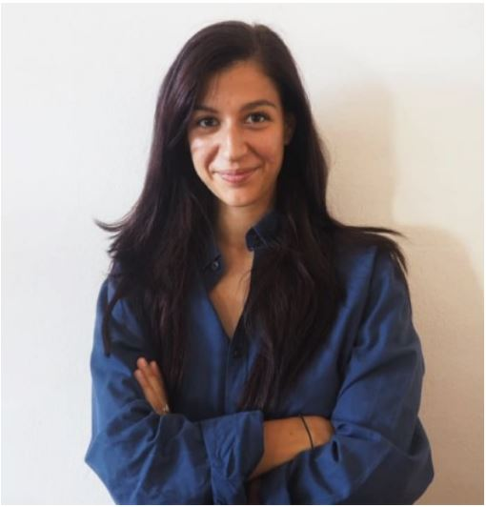
Students of the first generation of international doctoral studies "Sustainable Development" at the University of Montenegro
Tanja Radovanović
Master of Science / Master of Architecture
UX/UI Designer

Slide 24
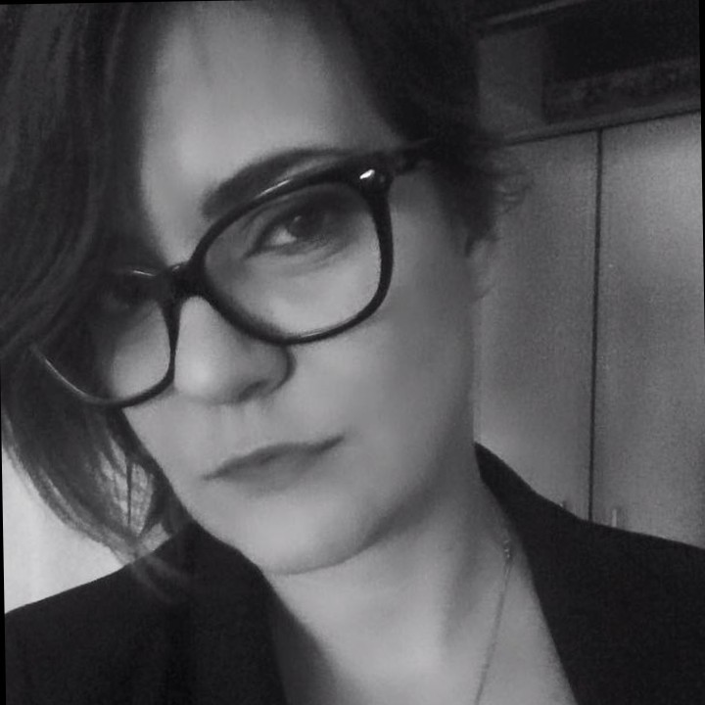
Students of the first generation of international doctoral studies "Sustainable Development" at the University of Montenegro
Vesna Pavlović
Master of Science – Biology
Implementation Manager at Ministry of Finance and Social Welfare

Slide 25


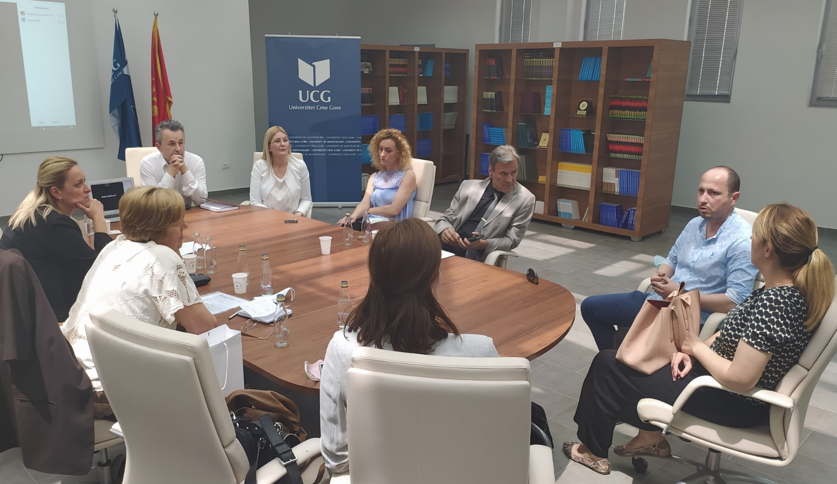
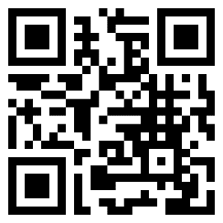

Slide 26

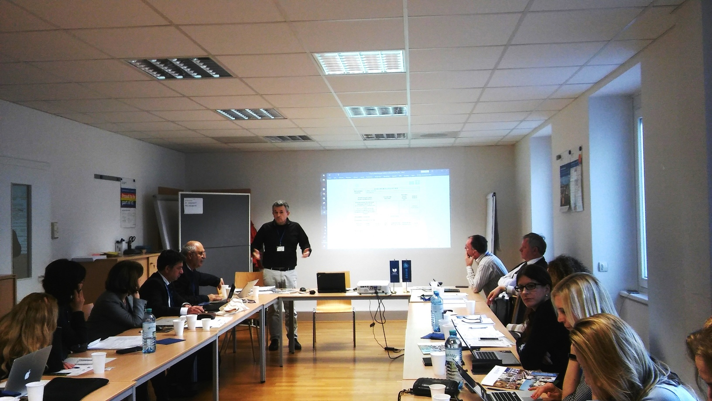

Slide 27

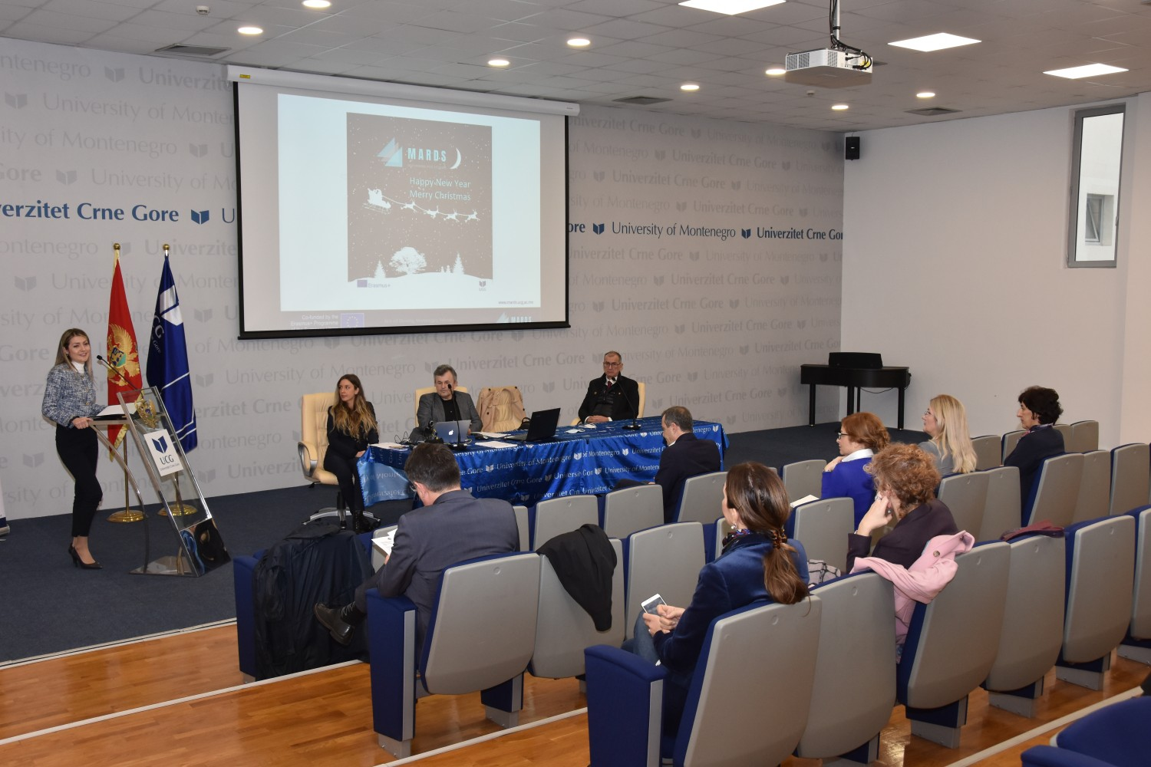

Slide 28
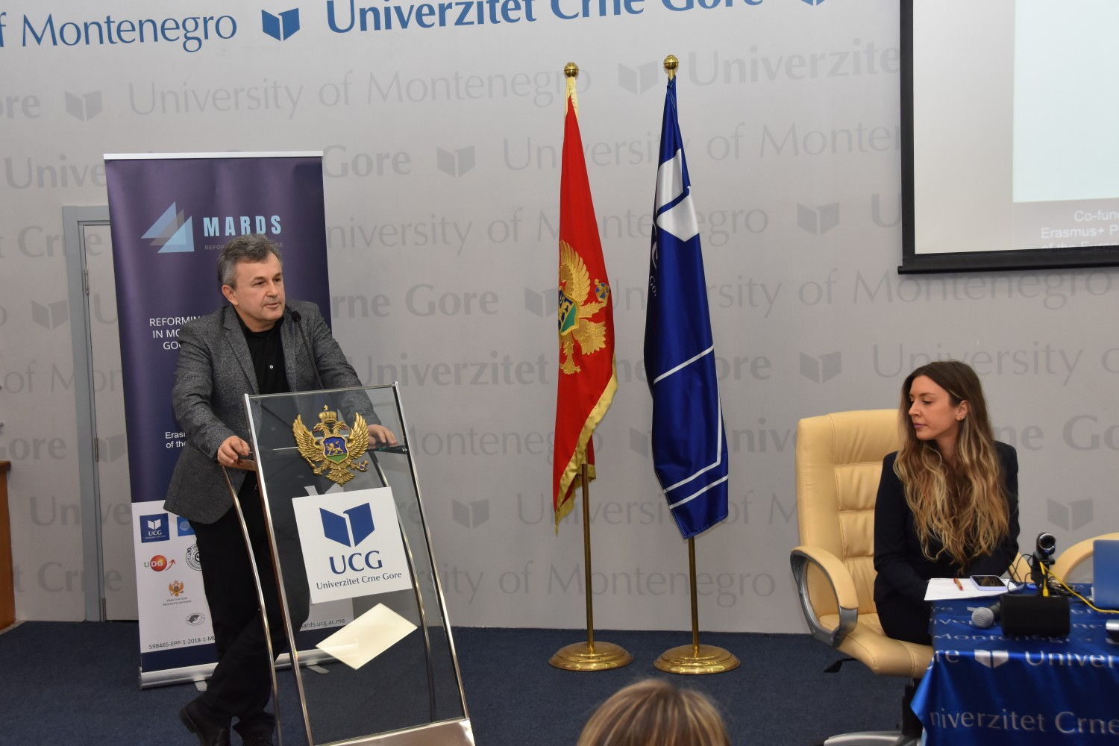
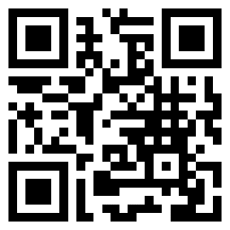

Slide 29

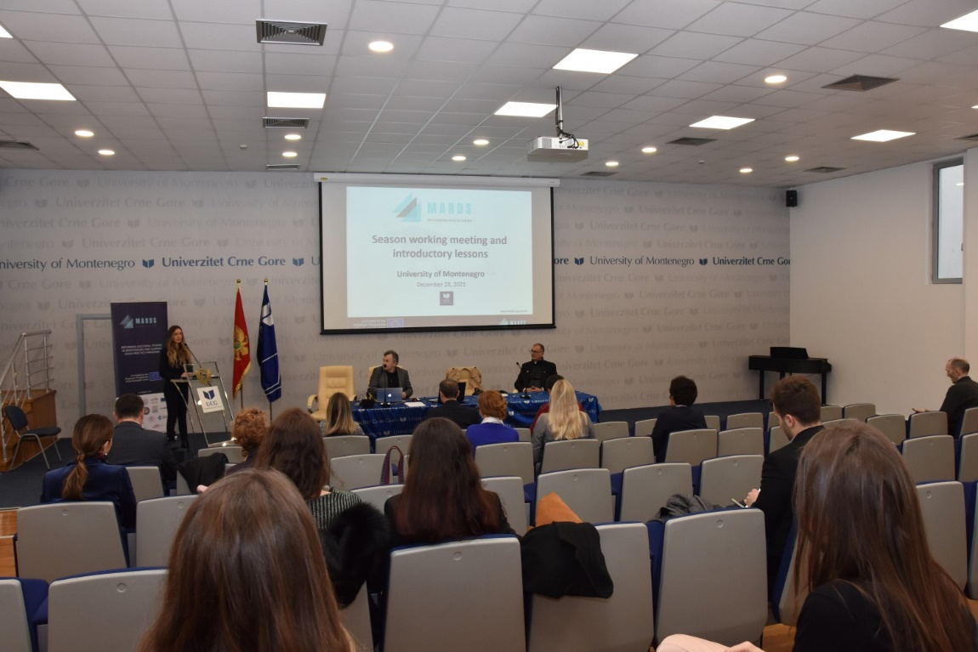

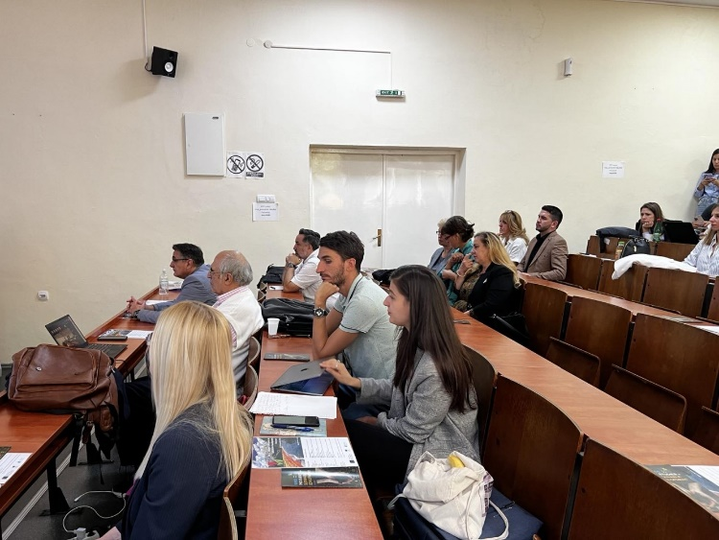

Slide 30

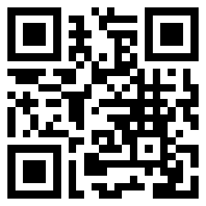
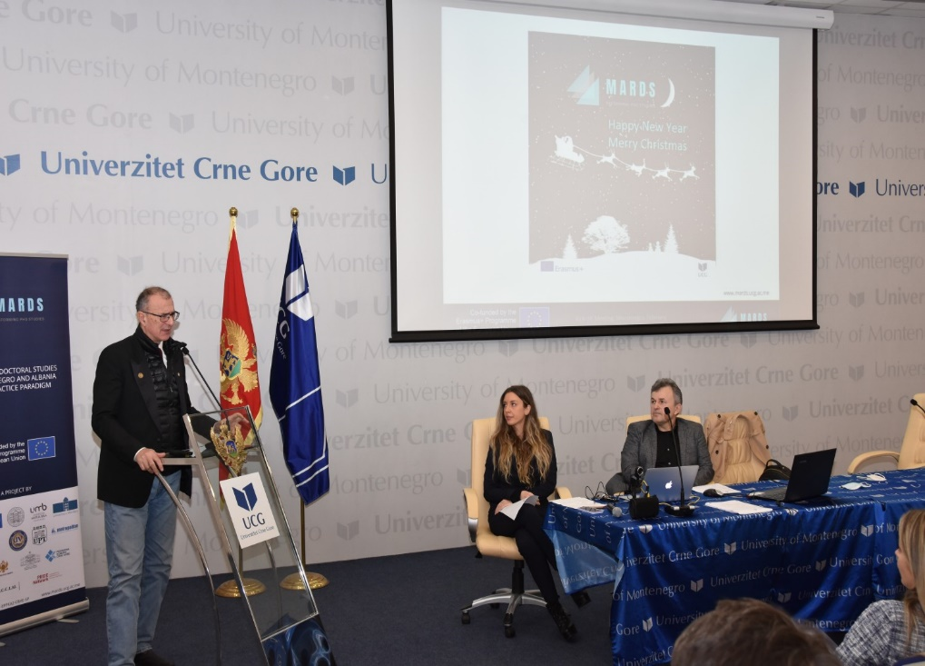
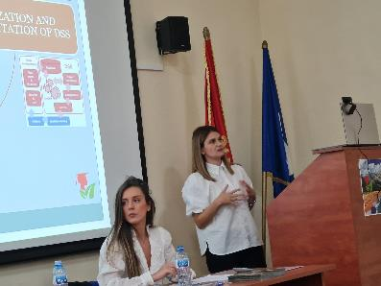

Slide 31


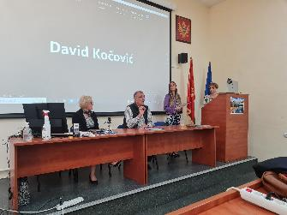
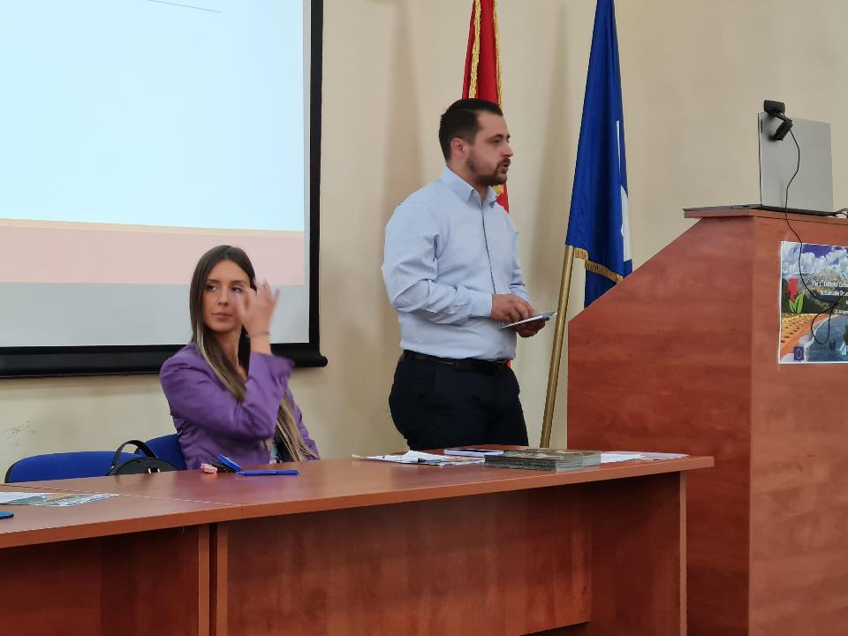
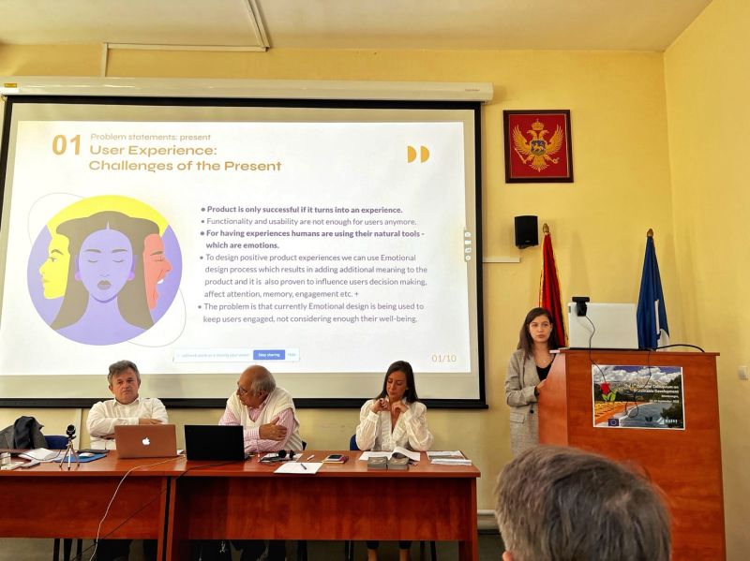

Slide 32
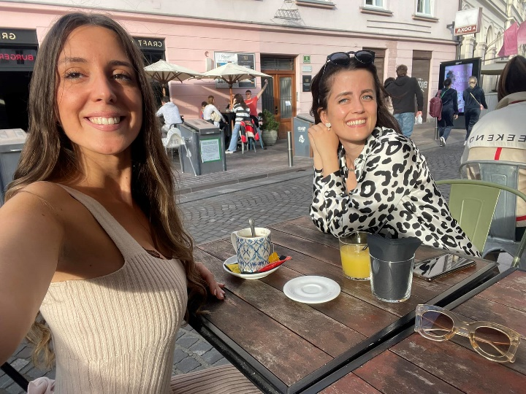
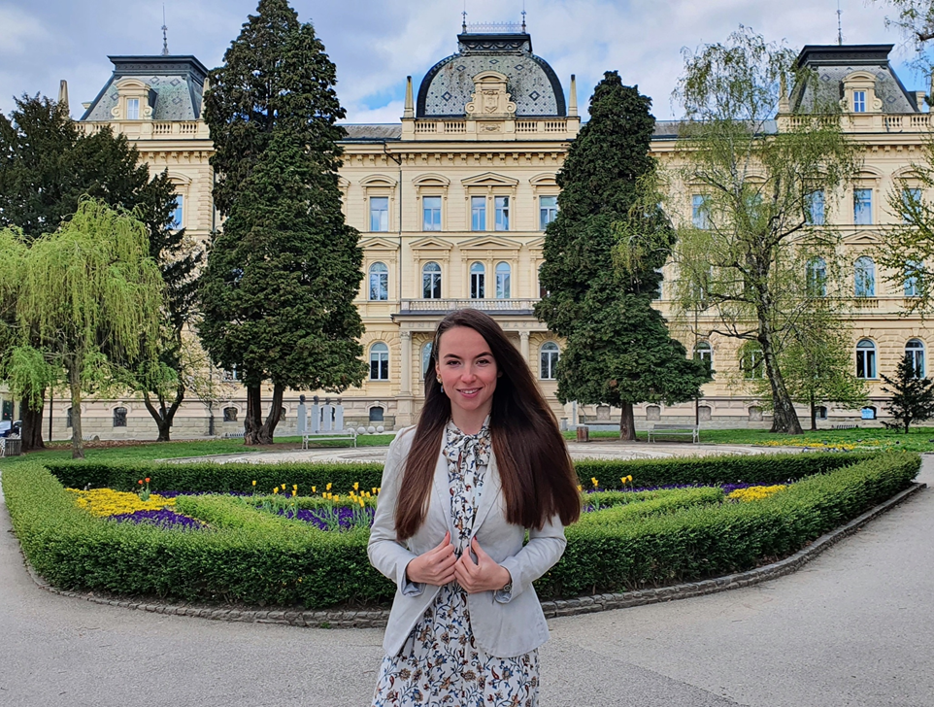
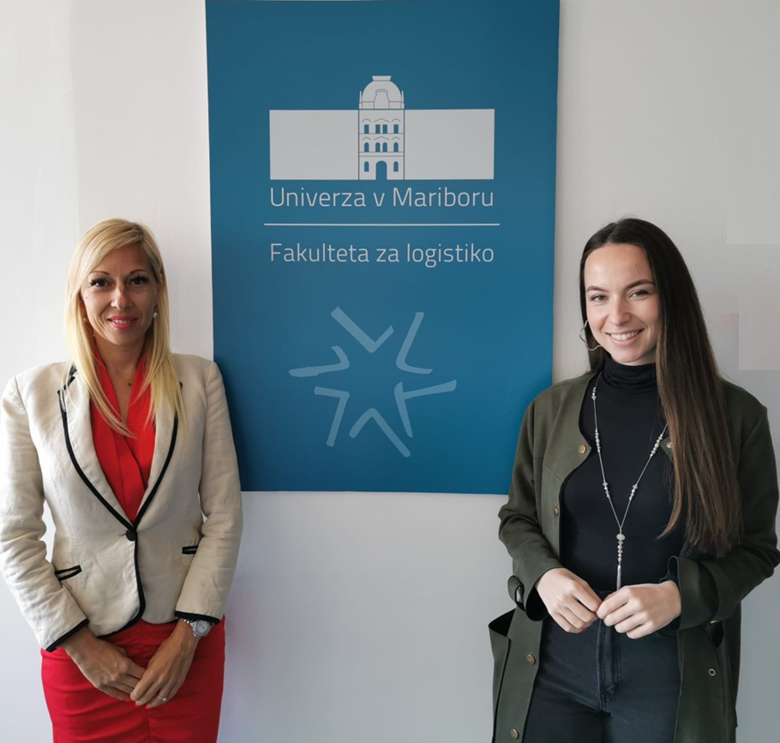
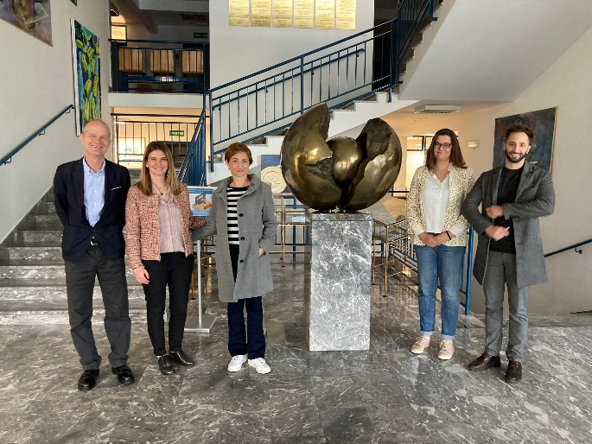

Slide 33

Conclusion
it was not an easy job.
somewhere we succeeded and somewhere we failed.
where we have succeeded, we will maintain it.
where we failed, we will always do it again.
because we believe in power of our idea

